Slide 1

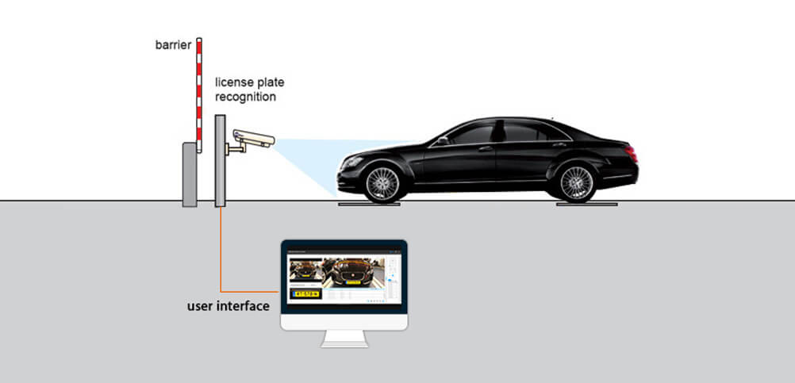
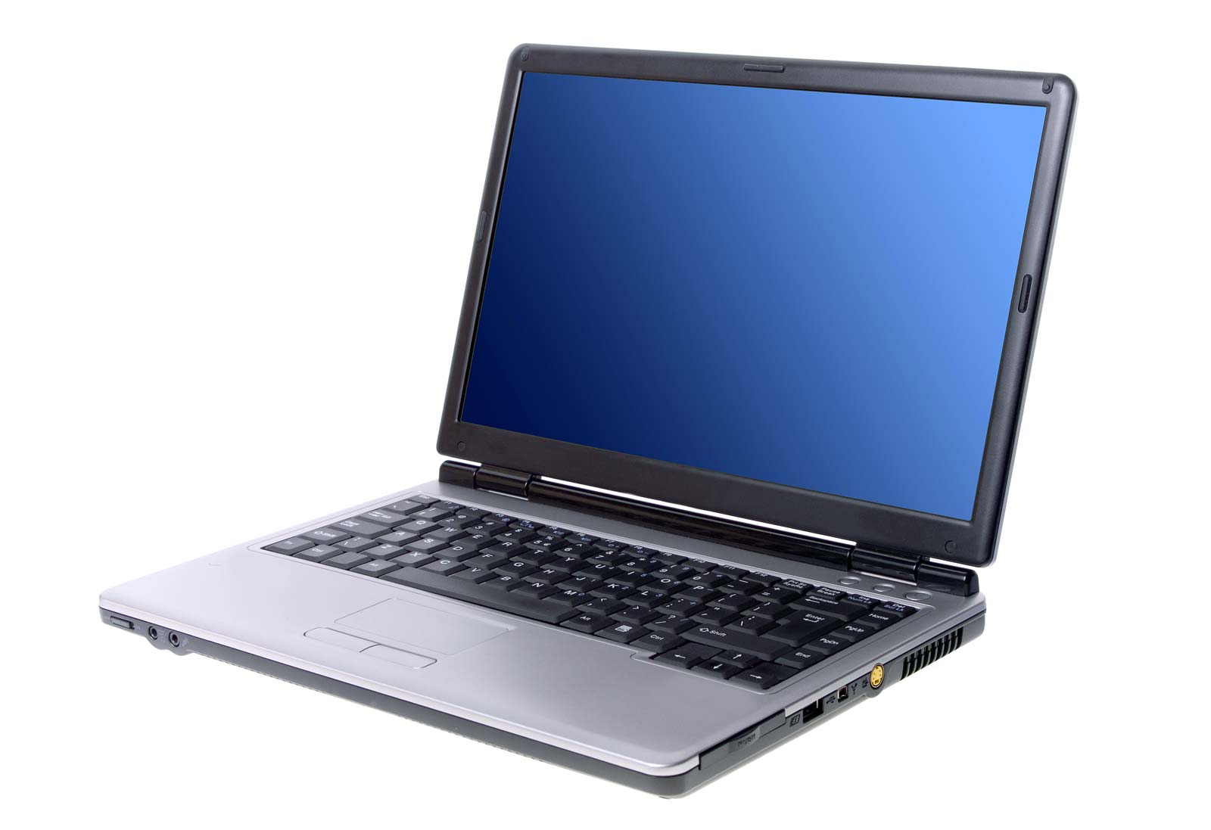
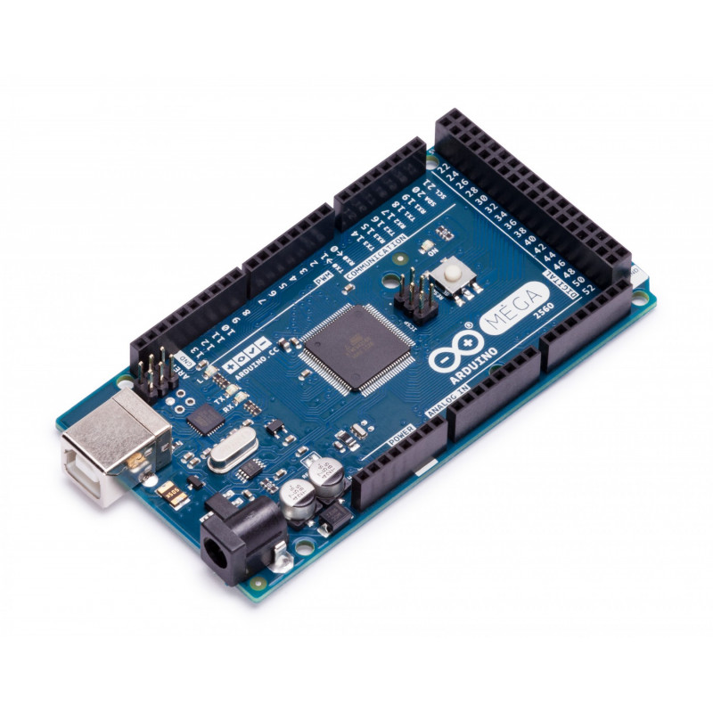
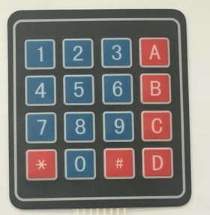
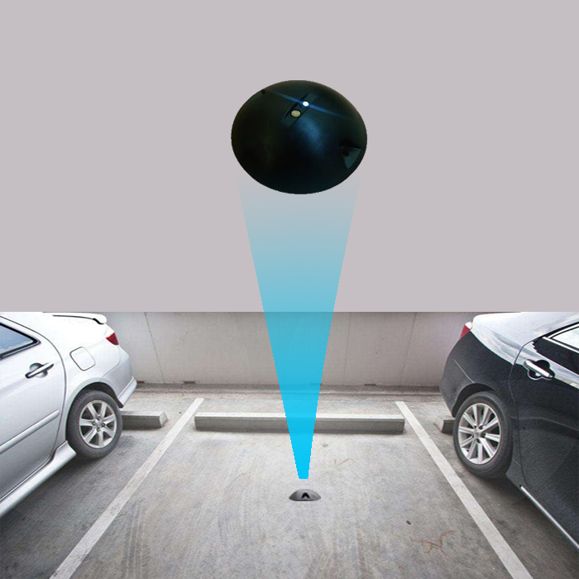
Forward the OTP through SMS to car driver
Camera detect the car plate and send video to the server
Send OTP through
Access Control Board (receive open signal from the server and send it the gate barrier, also receive signals from the parking sensor and keypad
Keypad (used to enter the OTP received via SMS)
Main server contains the plate recognition system , database control program and user interface
Parking sensor detects car existence

